Slide 1
Operating System

Slide 2
What is an Operating System?
A program that acts as an intermediary between a user of a computer and the computer hardware
Operating system goals:
Execute user programs and make solving user problems easier
Make the computer system convenient to use
Use the computer hardware in an efficient manner

Slide 3
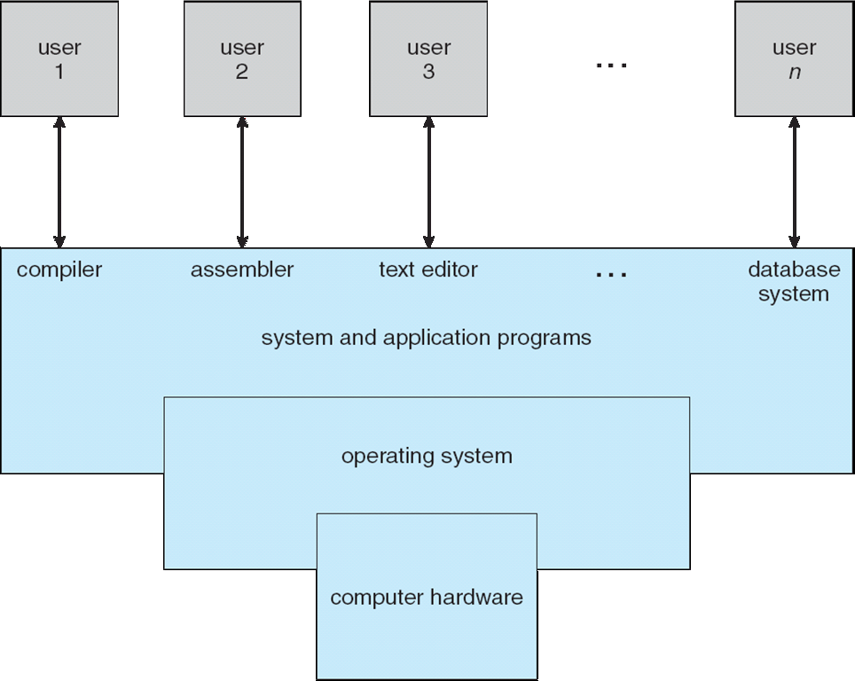
Four Components of a Computer System

Slide 4
What Operating Systems Do
Depends on the point of view
Users want convenience, ease of use and good performance
Don’t care about resource utilization
But shared computer such as mainframe or minicomputer must keep all users happy
Users of dedicate systems such as workstations have dedicated resources but frequently use shared resources from servers
Handheld computers are resource poor, optimized for usability and battery life
Some computers have little or no user interface, such as embedded computers in devices and automobiles

Slide 5
Operating System Definition
OS is a resource allocator
Manages all resources
Decides between conflicting requests for efficient and fair resource use
OS is a control program
Controls execution of programs to prevent errors and improper use of the computer

Slide 6
Operating System Definition (Cont.)
No universally accepted definition
“Everything a vendor ships when you order an operating system” is a good approximation
But varies wildly
“The one program running at all times on the computer” is the kernel.
Everything else is either
a system program (ships with the operating system) , or
an application program.

Slide 7
Computer Startup
bootstrap program is loaded at power-up or reboot
Typically stored in ROM or EPROM, generally known as firmware
Initializes all aspects of system
Loads operating system kernel and starts execution

Slide 8
Computer System Organization
Computer-system operation
One or more CPUs, device controllers connect through common bus providing access to shared memory
Concurrent execution of CPUs and devices competing for memory cycles

Slide 9
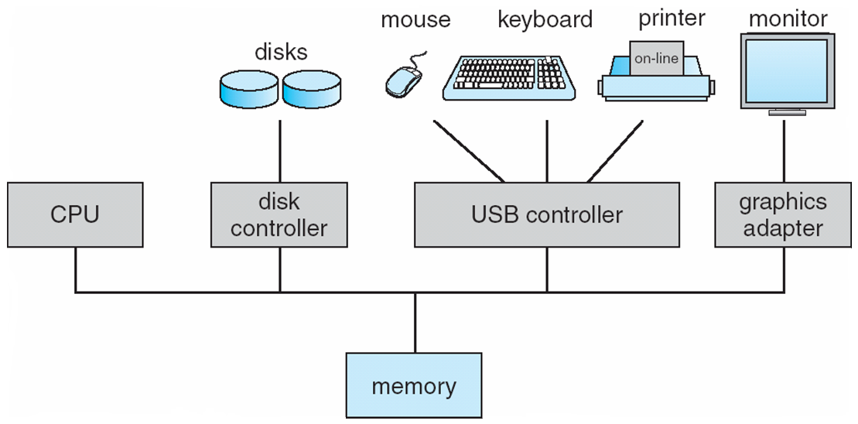

Slide 10
Computer-System Operation
I/O devices and the CPU can execute concurrently
Each device controller is in charge of a particular device type
Each device controller has a local buffer
CPU moves data from/to main memory to/from local buffers
I/O is from the device to local buffer of controller
Device controller informs CPU that it has finished its operation by causing an interrupt

Slide 11
Process Management
A process is a program in execution. It is a unit of work within the system. Program is a passive entity, process is an active entity.
Process needs resources to accomplish its task
CPU, memory, I/O, files
Initialization data
Process termination requires reclaim of any reusable resources
Single-threaded process has one program counter specifying location of next instruction to execute
Process executes instructions sequentially, one at a time, until completion
Multi-threaded process has one program counter per thread
Typically system has many processes, some user, some operating system running concurrently on one or more CPUs
Concurrency by multiplexing the CPUs among the processes / threads

Slide 12
Process Management Activities
The operating system is responsible for the following activities in connection with process management:
Creating and deleting both user and system processes
Suspending and resuming processes
Providing mechanisms for process synchronization
Providing mechanisms for process communication
Providing mechanisms for deadlock handling

Slide 13
Memory Management
To execute a program all (or part) of the instructions must be in memory
All (or part) of the data that is needed by the program must be in memory.
Memory management determines what is in memory and when
Optimizing CPU utilization and computer response to users
Memory management activities
Keeping track of which parts of memory are currently being used and by whom
Deciding which processes (or parts thereof) and data to move into and out of memory
Allocating and deallocating memory space as needed

Slide 14
Storage Management
OS provides uniform, logical view of information storage
Abstracts physical properties to logical storage unit - file
Each medium is controlled by device (i.e., disk drive, tape drive)
Varying properties include access speed, capacity, data-transfer rate, access method (sequential or random)
File-System management
Files usually organized into directories
Access control on most systems to determine who can access what
OS activities include
Creating and deleting files and directories
Primitives to manipulate files and directories
Mapping files onto secondary storage
Backup files onto stable (non-volatile) storage media

Slide 15
Mass-Storage Management
Usually disks used to store data that does not fit in main memory or data that must be kept for a “long” period of time
Proper management is of central importance
Entire speed of computer operation hinges on disk subsystem and its algorithms
OS activities
Free-space management
Storage allocation
Disk scheduling
Some storage need not be fast
Tertiary storage includes optical storage, magnetic tape
Still must be managed – by OS or applications
Varies between WORM (write-once, read-many-times) and RW (read-write)

Slide 16
I/O Subsystem
One purpose of OS is to hide peculiarities of hardware devices from the user
I/O subsystem responsible for
Memory management of I/O including buffering (storing data temporarily while it is being transferred), caching (storing parts of data in faster storage for performance), spooling (the overlapping of output of one job with input of other jobs)
General device-driver interface
Drivers for specific hardware devices

Slide 17
Protection and Security
Protection – any mechanism for controlling access of processes or users to resources defined by the OS
Security – defense of the system against internal and external attacks
Huge range, including denial-of-service, worms, viruses, identity theft, theft of service
Systems generally first distinguish among users, to determine who can do what
User identities (user IDs, security IDs) include name and associated number, one per user
User ID then associated with all files, processes of that user to determine access control
Group identifier (group ID) allows set of users to be defined and controls managed, then also associated with each process, file
Privilege escalation allows user to change to effective ID with more rights

